Slide 1

EEL 4781 Computer Communication Networks Chapter 1-2: Introduction to Networking Concepts
Xin Xin
Department of Electrical and Computer Engineering
University of Central Florida

Slide 2
Today’s Agenda
Quick Review
Performance
loss, delay, throughput
Queueing Theory
M/M/1
Network core
packet/circuit switching
ISP

Slide 3

Performance
How do packet loss and delay occur?
packets queue in router buffers
packets queue, wait for turn
arrival rate to link (temporarily) exceeds output link capacity: packet loss
packet being transmitted (transmission delay)
A
B
packets in buffers (queueing delay)
free (available) buffers: arriving packets
dropped (loss) if no free buffers

Slide 4
Performance
Packet delay: four sources
transmission
A
propagation
B
nodal
processing
queueing
d_{nodal} = d_{proc} + d_{queue} + d_{trans} + d_{prop}
d_{proc}: nodal processing
check bit errors
determine output link
typically < msec
d_{queue}: queueing delay
time waiting at output link for transmission
depends on congestion level of router

Slide 5
Performance
Packet delay: four sources
transmission
A
propagation
B
nodal
processing
queueing
d_{nodal} = d_{proc} + d_{queue} + d_{trans} + d_{prop}
d_{trans}: transmission delay:
L: packet length (bits)
R: link transmission rate (bps)
d_{trans} = L/R
d_{prop}: propagation delay:
d: length of physical link
s: propagation speed (~2x10⁸ m/sec)
d_{prop} = d/s
d_{trans} and d_{prop}
very different
* Check out the online interactive exercises: http://gaia.cs.umass.edu/kurose_ross

Slide 6

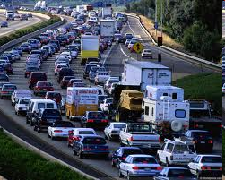
Performance
Packet queueing delay
R: link bandwidth (bps)
L: packet length (bits)
a: average packet arrival rate
average queueing delay
La/R ~ 0: avg. queueing delay small
La/R -> 1: avg. queueing delay large
La/R > 1: more “work” arriving is more than can be serviced - average delay infinite!
traffic intensity = La/R
1
La/R ~ 0
La/R -> 1

Slide 7
Performance
“Real” Internet delays and routes
what do “real” Internet delay & loss look like?
traceroute program: provides delay measurement from source to router along end-end Internet path towards destination. For all i:
sends three packets that will reach router i on path towards destination (with time-to-live field value of i)
router i will return packets to sender
sender measures time interval between transmission and reply
3 probes
3 probes
3 probes

Slide 8
Real Internet delays and routes
traceroute: gaia.cs.umass.edu to www.eurecom.fr
3 delay measurements from
gaia.cs.umass.edu to cs-gw.cs.umass.edu
1 cs-gw (128.119.240.254) 1 ms 1 ms 2 ms
2 border1-rt-fa5-1-0.gw.umass.edu (128.119.3.145) 1 ms 1 ms 2 ms
3 cht-vbns.gw.umass.edu (128.119.3.130) 6 ms 5 ms 5 ms
4 jn1-at1-0-0-19.wor.vbns.net (204.147.132.129) 16 ms 11 ms 13 ms
5 jn1-so7-0-0-0.wae.vbns.net (204.147.136.136) 21 ms 18 ms 18 ms
6 abilene-vbns.abilene.ucaid.edu (198.32.11.9) 22 ms 18 ms 22 ms
7 nycm-wash.abilene.ucaid.edu (198.32.8.46) 22 ms 22 ms 22 ms
8 62.40.103.253 (62.40.103.253) 104 ms 109 ms 106 ms
9 de2-1.de1.de.geant.net (62.40.96.129) 109 ms 102 ms 104 ms
10 de.fr1.fr.geant.net (62.40.96.50) 113 ms 121 ms 114 ms
11 renater-gw.fr1.fr.geant.net (62.40.103.54) 112 ms 114 ms 112 ms
12 nio-n2.cssi.renater.fr (193.51.206.13) 111 ms 114 ms 116 ms
13 nice.cssi.renater.fr (195.220.98.102) 123 ms 125 ms 124 ms
14 r3t2-nice.cssi.renater.fr (195.220.98.110) 126 ms 126 ms 124 ms
15 eurecom-valbonne.r3t2.ft.net (193.48.50.54) 135 ms 128 ms 133 ms
16 194.214.211.25 (194.214.211.25) 126 ms 128 ms 126 ms
17 * * *
18 * * *
19 fantasia.eurecom.fr (193.55.113.142) 132 ms 128 ms 136 ms
3 delay measurements
to border1-rt-fa5-1-0.gw.umass.edu
trans-oceanic link
looks like delays decrease! Why?
* means no response (probe lost, router not replying)
* Do some traceroutes from exotic countries at www.traceroute.org

Slide 9
Performance
Packet loss
queue (aka buffer) preceding link in buffer has finite capacity
packet arriving to full queue dropped (aka lost)
lost packet may be retransmitted by previous node, by source end system, or not at all
buffer
(waiting area)
packet being transmitted
A
B
packet arriving to
full buffer is lost
* Check out the Java applet for an interactive animation on queuing and loss

Slide 10
Performance
Throughput
throughput: rate (bits/time unit) at which bits are being sent from sender to receiver
instantaneous: rate at given point in time
average: rate over longer period of time
link capacity
R_{s} bits/sec
link capacity
R_{c} bits/sec
pipe that can carry
fluid at rate
(R_{s} bits/sec)
pipe that can carry
fluid at rate
(R_{c} bits/sec)
server sends bits
(fluid) into pipe
server, with
file of F bits
to send to client

Slide 11
Performance
Throughput
R_{s} < R_{c} What is average end-end throughput?
R_{s} bits/sec
R_{c} bits/sec
R_{s} > R_{c} What is average end-end throughput?
R_{s} bits/sec
R_{c} bits/sec
bottleneck link
link on end-end path that constrains end-end throughput

Slide 12
Performance
Throughput
per-connection end-end throughput: min(R_{c},R_{s},R/10)
in practice: R_{c} or R_{s} is often bottleneck
R_{s}
R_{s}
R_{s}
R
R_{c}
R_{c}
R_{c}
* Check out the online interactive exercises for more examples: http://gaia.cs.umass.edu/kurose_ross/
10 connections (fairly) share backbone bottleneck link R bits/sec

Slide 13
Queueing Theory
M/M/1
An M/M/1 (in Kendall's notation) queue is a stochastic process, which represents the queue length in a system having a single server, where arrivals are determined by a Poisson process and job service times have an exponential distribution.
Arrivals occur at rate λ according to a Poisson process.
Service times have an exponential distribution with rate parameter μ.
All arrival times and services times are assumed to be independent of one another.
A single server serves customers one at a time, according to a FCFS (first-come, first-served) discipline.
When the service is complete the customer leaves the queue and the number of customers in the system reduces by one.
The buffer is of infinite size, so there is no limit on the number of customers it can contain.

Slide 14
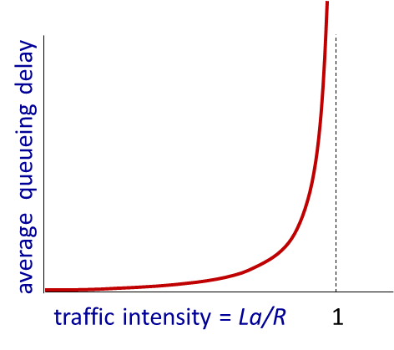
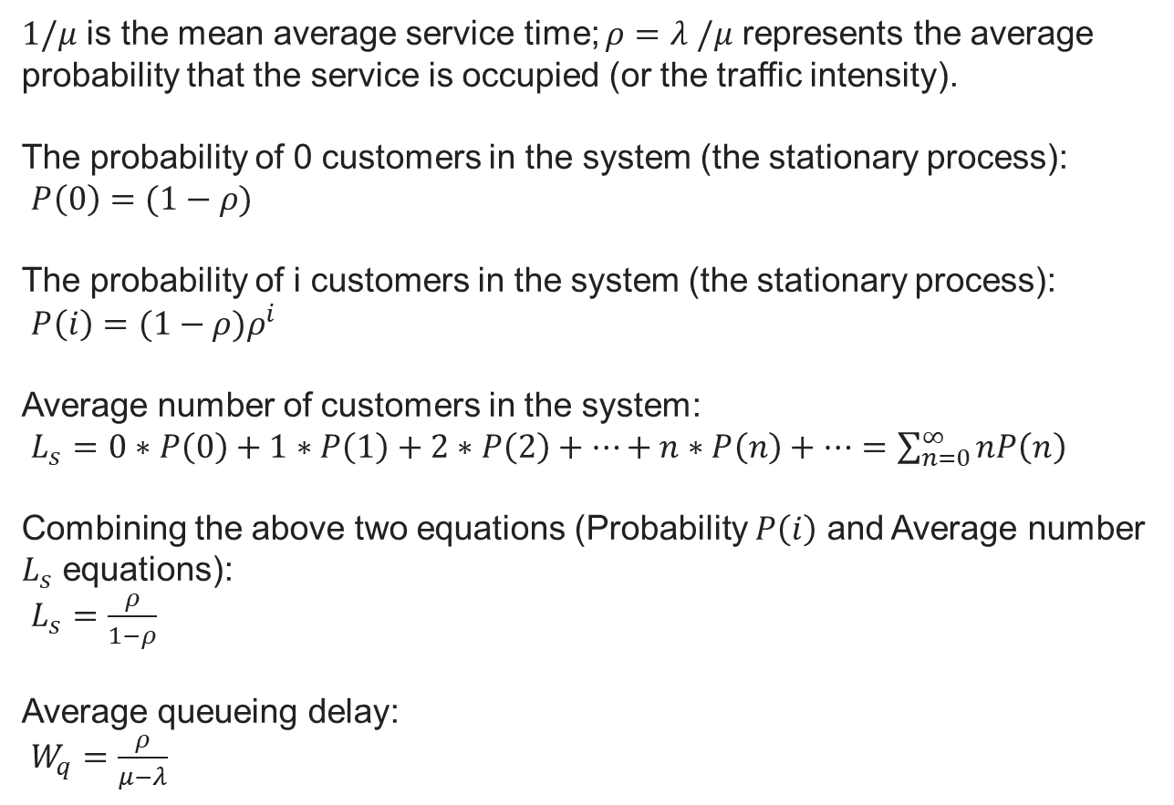
Queueing Theory
$1/μ$ is the mean average service time; $ρ=λ$ $/μ$ represents the average probability that the service is occupied (or the traffic intensity).
The probability of 0 customers in the system (the stationary process):
$P\left(0\right)=(1−ρ)$
The probability of i customers in the system (the stationary process):
$P\left(i\right)=(1−ρ)ρ^{i}$
Average number of customers in the system:
$L_{s}=0∗P\left(0\right)+1∗P\left(1\right)+2∗P\left(2\right)+…+n∗P\left(n\right)+…=\sum_{n=0}^{∞}{nP\left(n\right)}$
Combining the above two equations (Probability $P\left(i\right)$ and Average number $L_{s}$ equations):
$L_{s}=\frac{ρ}{1−ρ}$
Average queueing delay:
$W_{q}=\frac{ρ}{μ−λ}$

Slide 15
















Network Core
mesh of interconnected routers
packet-switching: hosts break application-layer messages into packets
forward packets from one router to the next, across links on path from source to destination
each packet transmitted at full link capacity
packet-switching devices
Routers
Link-layer switches
terms forwarding and switching are often used interchangeably
mobile network
national or global ISP
local or regional ISP
home network
content
provider
network
datacenter
network
enterprise
network

Slide 16
Network Core
Two key network-core functions
routing algorithm
Routing:
global action: determine source-destination paths taken by packets
routing algorithms
routing algorithm
Forwarding:
local action: move arriving packets from router’s input link to appropriate router output link
local forwarding table
local forwarding table
header value
output link
0100
0101
0111
1001
3
2
2
1
1
3
2
0111
destination address in arriving
packet’s header

Slide 17



Network Core
Packet-switching: store-and-forward
L bits
per packet
source
3
2
1
destination
R bps
R bps
Transmission delay: takes L/R seconds to transmit (push out) L-bit packet into link at R bps
Store and forward: entire packet must arrive at router before it can be transmitted on next link
End-end delay: 2L/R (above), assuming zero propagation delay (more on delay shortly)
One-hop numerical example:
L = 10 Kbits
R = 100 Mbps
one-hop transmission delay = 0.1 msec

Slide 18
Network Core
Packet-switching: queueing delay, loss
R = 100 Mb/s
C
A
R = 1.5 Mb/s
D
B
E
queue of packets
waiting for output link
Packet queuing and loss: if arrival rate (in bps) to link exceeds transmission rate (bps) of link for a period of time:
packets will queue, waiting to be transmitted on output link
packets can be dropped (lost) if memory (buffer) in router fills up

Slide 19
Network Core
Alternative to packet switching: circuit switching
End-end resources allocated to, reserved for “call” between source and destination
in diagram, each link has four circuits.
call gets 2nd circuit in top link and 1st circuit in right link.
dedicated resources: no sharing
circuit-like (guaranteed) performance
circuit segment idle if not used by call (no sharing)
commonly used in traditional telephone networks

Slide 20
Network Core
Circuit switching: FDM and TDM
Frequency Division Multiplexing (FDM)
optical, electromagnetic frequencies divided into (narrow) frequency bands
each call allocated its own band, can transmit at max rate of that narrow band
4 users
frequency
time
Time Division Multiplexing (TDM)
time divided into slots
each call allocated periodic slot(s), can transmit at maximum rate of (wider) frequency band, but only during its time slot(s)
frequency
time

Slide 21
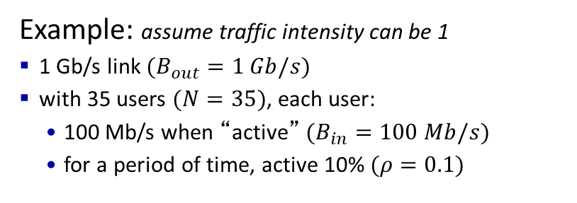
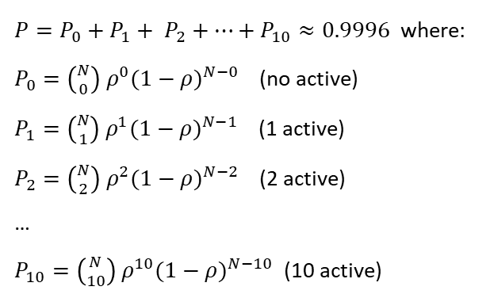
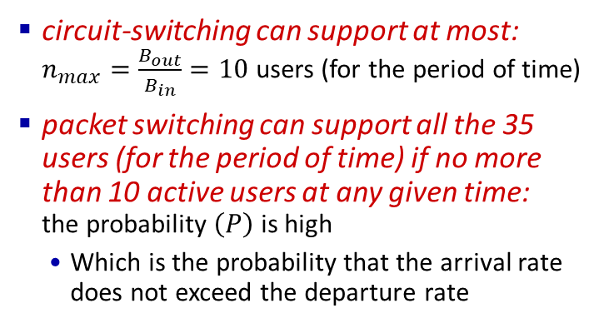
Network Core
Packet switching versus circuit switching
packet switching allows more users to use network!
Example: assume traffic intensity can be 1
1 Gb/s link $(B_{out}=1 Gb/s)$
with 35 users $(N=35)$, each user:
100 Mb/s when “active” $(B_{in}=100 Mb/s)$
for a period of time, active 10% $(ρ=0.1)$
…..
N
users
1 Gbps link
circuit-switching can support at most: $n_{max}=\frac{B_{out}}{B_{in}}=10$ users (for the period of time)
packet switching can support all the 35 users (for the period of time) if no more than 10 active users at any given time: the probability $\left(P\right)$ is high
Which is the probability that the arrival rate does not exceed the departure rate
$P=P_{0}+P_{1}+ P_{2}+…+P_{10}≈0.9996$ where:
$P_{0}={\left({N \atop 0}\right){ ρ}^{0}(1−ρ)}^{N−0}$ (no active)
$P_{1}={\left({N \atop 1}\right){ ρ}^{1}(1−ρ)}^{N−1}$ (1 active)
$P_{2}={\left({N \atop 2}\right){ ρ}^{2}(1−ρ)}^{N−2}$ (2 active)
…
$P_{10}={\left({N \atop 10}\right){ ρ}^{10}(1−ρ)}^{N−10}$ (10 active)

Slide 22
Network Core
Packet switching versus circuit switching
Is packet switching a “slam dunk winner”?
great for “bursty” data – sometimes has data to send, but at other times not
resource sharing
simpler, no call setup
excessive congestion possible: packet delay and loss due to buffer overflow
protocols needed for stable and reliable data transfer, congestion control
Q: How to provide circuit-like behavior?
bandwidth guarantees traditionally used for audio/video applications
still an unsolved problem
overprovisioning often used

Slide 23
Network Core
Internet: a “network of networks”
Hosts connect to Internet via access Internet Service Providers (ISPs)
residential, enterprise (company, university, commercial) ISPs
Access ISPs in turn must be interconnected
so that any two hosts can send packets to each other
Resulting network of networks is very complex
evolution was driven by economics and national policies
Let’s take a stepwise approach to describe current Internet structure

Slide 24
Network Core
Internet: a “network of networks”
Question: given millions of access ISPs, how to connect them together?
…
access
net
…
access
net
access
net
access
net
access
net
access
net
access
net
…
…
access
net
access
net
access
net
access
net
access
net
…
access
net
access
net
access
net
access
net
…

Slide 25
Network Core
Internet: a “network of networks”
Question: given millions of access ISPs, how to connect them together?
…
access
net
…
access
net
access
net
access
net
…
…
access
net
access
net
access
net
…
connecting each access ISP to each other directly doesn’t scale: O(N²) connections.
…
…
access
net
access
net
…
access
net
access
net
access
net
…
…
access
net
access
net
access
net
access
net
…

Slide 26
Network Core
Internet: a “network of networks”
Option: connect each access ISP to one global transit ISP?
Customer and provider ISPs have economic agreement.
…
access
net
…
access
net
access
net
access
net
access
net
access
net
access
net
…
…
global ISP
access
net
access
net
access
net
access
net
access
net
…
access
net
access
net
access
net
access
net
…

Slide 27
Network Core
Internet: a “network of networks”
But if one global ISP is viable business, there will be competitors ….
…
access
net
…
access
net
access
net
access
net
access
net
access
net
ISP A
access
net
…
…
access
net
ISP B
access
net
ISP C
access
net
access
net
access
net
…
access
net
access
net
access
net
access
net
…

Slide 28
Network Core
Internet: a “network of networks”
But if one global ISP is viable business, there will be competitors …. who will want to be connected and regional networks may arise to connect access nets to ISPs
…
Internet exchange point
access
net
access
net
…
access
net
access
net
access
net
IXP
access
net
access
net
ISP A
…
…
access
net
IXP
ISP B
access
net
ISP C
access
net
access
net
access
net
regional ISP
…
access
net
access
net
access
net
access
net
…
peering link

Slide 29
Network Core
Internet: a “network of networks”
Tier 1 ISP
Tier 1 ISP
Google
IXP
IXP
IXP
Regional ISP
Regional ISP
access
ISP
access
ISP
access
ISP
access
ISP
access
ISP
access
ISP
access
ISP
access
ISP
At “center”: small # of well-connected large networks
“tier-1” commercial ISPs (e.g., Level 3, Sprint, AT&T, NTT), national & international coverage
content provider networks (e.g., Google, Facebook): private network that connects its data centers to Internet, often bypassing tier-1, regional ISPs

Slide 30
Thanks
Acknowledgment
The materials for this course are in part based upon the materials from a number of people/sources, including:
Official website of the Kurose and Ross text: Computer Networking: A Top-Down Approach
Official website of the Tanenbaum & Wetherall text: Computer Networks
Dr. Murat Yuksel: https://www.ece.ucf.edu/~yuksem/teaching/EEL-4781-Fall-2020.html
Dr. Raj Jain: https://www.cse.wustl.edu/~jain/

Slide 31

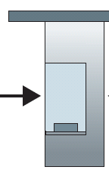
Convoy analogy
100 km
100 km
ten-car Convoy
(aka 10-bit packet)
toll booth
(aka router)
toll booth
cars “propagate” at 100 km/hr
toll booth takes 12 sec to service car (bit transmission time)
car ~ bit; convoy ~ packet
Q: How long until Convoy is lined up before 2nd toll booth?
time to “push” entire Convoy through toll booth onto highway = 12*10 = 120 sec
time for last car to propagate from 1st to 2nd toll both: 100km/(100km/hr) = 1 hr
A: 62 minutes

Slide 32
Convoy analogy
100 km
100 km
ten-car Convoy
(aka 10-bit packet)
toll booth
(aka router)
toll booth
suppose cars now “propagate” at 1000 km/hr
and suppose toll booth now takes one min to service a car
Q: Will cars arrive to 2nd booth before all cars serviced at first booth?
A: Yes! after 7 min, first car arrives at second booth; three cars still at first booth

